Slide 1
Automatic segmentation of fibula bone by using deep learning
Promotor: Prof. Bart Vanrumste
Co-supervisor: Dr. Yi Sun
Beiyang Li r0735133
Zechun Wang r0736595
Notes:
李 Good afternoon, everyone, I am xxxx, (I am xxx) thanks for coming to our presentation. Before the start, we’d like to express our thanks to our promotor Bart and co-supervisor Yi Sun. They gave us strong support during this project. By the way, today is the first day of traditional Chinese new Year. Happy Spring Festival. Then, my teammate and me will present our research.

Slide 2
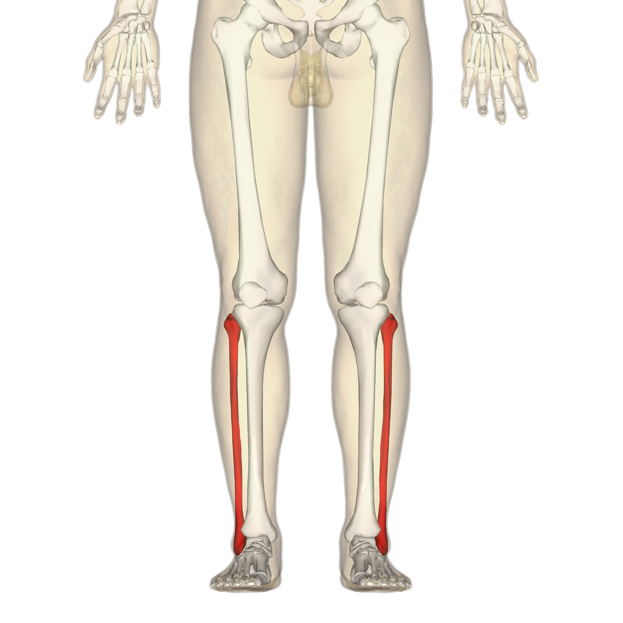
Subject of master thesis
Proposes an automatic fibula segmentation approach in CT scans
Notes:
In this research, we aim to Propose an automatic fibula segmentation approach in CT scans .

Slide 3
Outline
Motivation
Dataset & Data preprocessing
Methodology & Experiments
Conclusion
Notes:
Our research will be presented from 4 aspects: Motivation, Dataset and Data preprocesssing, methodology and Experiments, and conclusion.

Slide 4
Outline
Motivation
Dataset & Data preprocessing
Methodology & Experiments
Conclusion
Notes:
First is the motivation part.

Slide 5
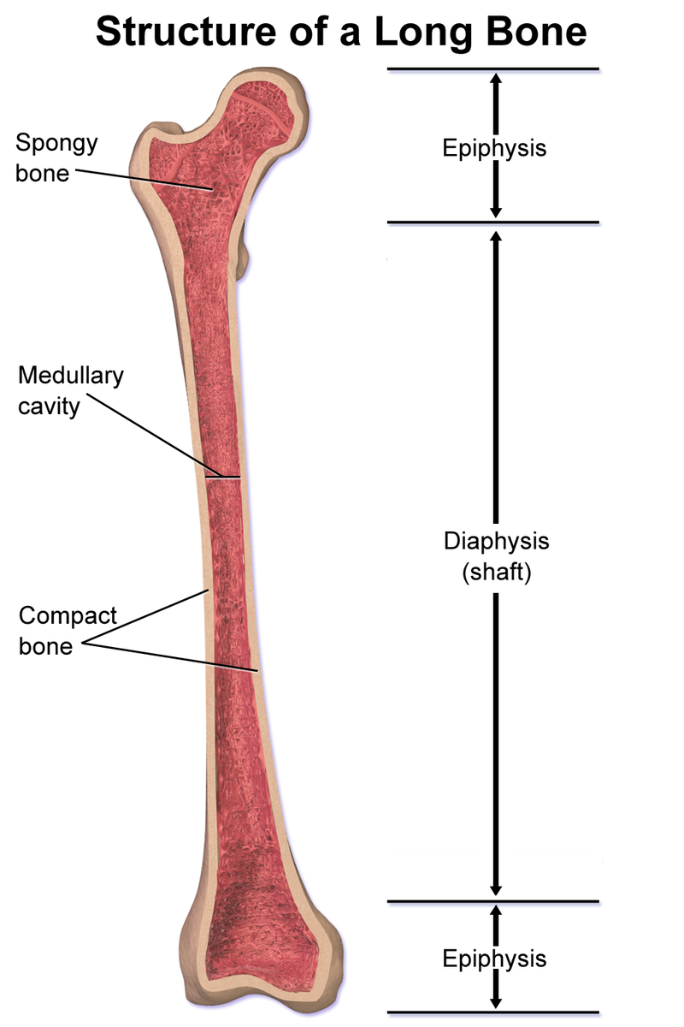
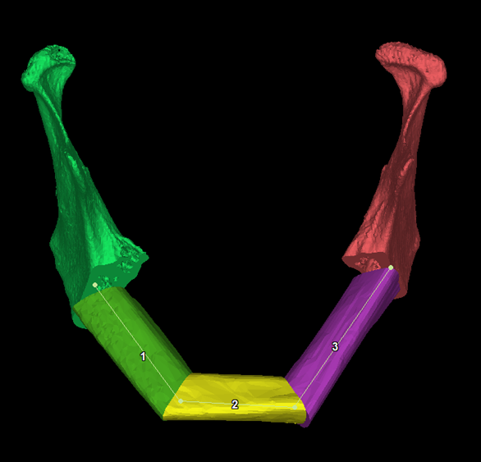
Concept of Fibula
The fibula is a leg bone on the lateral side of the tibia.
Segmentation of fibula is commonly used in the mandibular reconstruction.
Notes:
王 The fibula is a leg bone on the lateral side of the tibia
Mandibular reconstruction is a commonly performed medical procedure. The procedure need to use free fibula flap, so the segmentation of fibula is needed.
(The epiphysis is the rounded end of a long bone, at its joint with adjacent bone.
The diaphysis is the main of a long bone.)

Slide 6
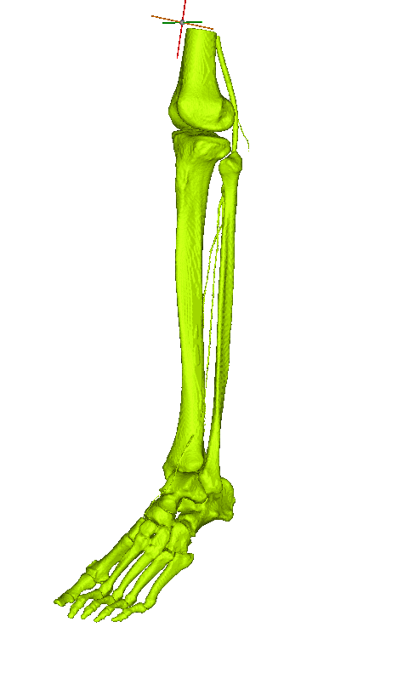
The traditiontal fibula segmentation method
Traditional medical segmentation adopts thresholding algorithm method with the assistant of manual annotations.
The segmentation results of thresholding algorithm cannot be directly adopted in clinical applications, experts are still required to spend lots of time to further manually improve on the results’ quality. Zhou et al. (2019)
Zhou, Chen, L., & Wang, Z. (2019). Interactive Deep Editing Framework for Medical Image Segmentation. In Medical Image Computing and Computer Assisted Intervention – MICCAI 2019 (Vol. 11766, pp. 329–337). Springer International Publishing. https://doi.org/10.1007/978-3-030-32248-9_37
Notes:
Traditional segmentation of fibula adopts the thresholding algorithm, which cannot be directly adopted in clinical applications.
An example of thresholding result shown there, it can only select the bone parts.
So, the experts are still need to spend lots of time to further manually improve on the results’ quality.
To improve the efficiency and help to save the time and energy of experts, we aim to propose an automatic segmentation neural network.

Slide 7
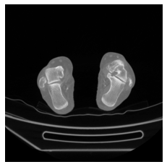
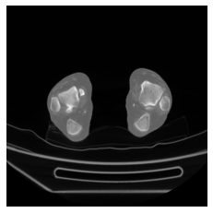
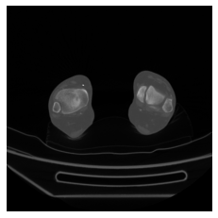
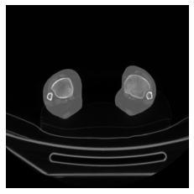
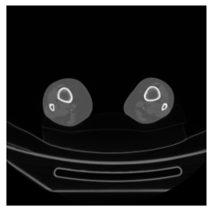
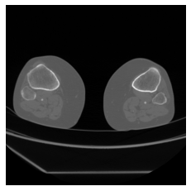
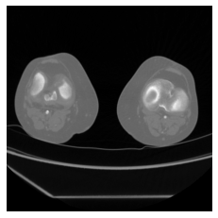
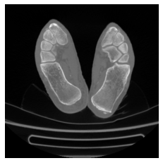
Challenge
Notes:
Here are 8 images example of one CT scan.
The first six images contain the portion of fibula but there is a great difference in shape.
In the two circled images, there are other structures which is similar to fibula but not fibula, which is also a big challenge for segmentation.
In addition, fibula in CT scans has large variations in different individuals.

Slide 8
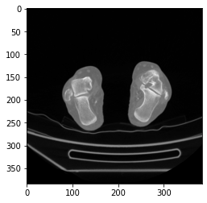
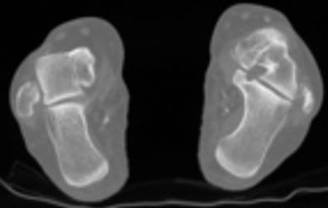
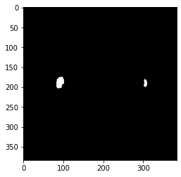
What is segmentation
0 0 0 0 0 0 0 0 0 0 0 0 0 0 0 0 0 0 0 0 0 0 0 0 0 0 0 0 0 0 0 0 0 0 0 0 0 0 0 0 0 0 0 0 0 0 0 0 0 0 0 0 0 0 0 0 0 0 0 0 0 0 0 0 0 0 0 0 0 0 0 0 0 0 0 0 0 0 0 0 0 0 0 0 0 0 0 0 0 0 0 0 0 0 0 0 0 0 0 0 0 0 0 0 0 0 0 0 0 0 0 0 0 0 0 0 0 0 0 0 0 0 0 0 0 0 0 0 0 0 0 0 0 0 0 0 0 0 0 0 0 0 0 0 0 0 0 0 0 0 0 0 0 0 0 0 0 0 0 0 0 0 0 0 0 0 0 0 0 0 0 0 0 0 0 0 0 0 0 0 0 0 0 0 0 0 0 0 0 0 0 0 0 0 0 0 0 0 0 0 0 0 0 0 0 0 0 0 0 0 0 0 0 0 0 0 0 0 0 1 1 0 0 0 0 0 0 0 0 0 0 0 0 0 0 0 0 0 0 0 0 0 0 0 0 1 1 0 0 1 1 1 0 0 0 0 0 0 0 0 0 0 0 0 0 0 0 0 0 0 0 0 0 0 0 0 1 1 0 0 0 1 0 0 0 0 0 0 0 0 0 0 0 0 0 0 0 0 0 0 0 0 0 0 0 0 0 0 0 0 0 0 0 0 0 0 0 0 0 0 0 0 0 0 0 0 0 0 0 0 0 0 0 0 0 0 0 0 0 0 0 0 0 0 0 0 0 0 0 0 0 0 0 0 0 0 0 0 0 0 0 0 0 0 0 0 0 0 0 0 0 0
0 0 0 0 0 0 0 0 0 0 0 0 0 0 0 0 0 0 0 0 0 0 0 0 0 0 0 0 0 0 0 0 0 0 0 0 0 0 0 0 0 0 0 0 0 0 0 0 0 0 0 0 0 0 0 0 0 0 0 0 0 0
0 0 0 0 0 0 0 0 0 0 0 0 0 0 0 0 0 0 0 0 0 0 0 0 0 0 0 0 0 0 0 0 0 0 0 0 0 0 0 0 0 0 0 0 0 0 0 0 0 0 0 0 0 0 0 0 0 0 0 0 0 0
0 0 0 0 0 0 0 0 0 0 0 0 0 0 0 0 0 0 0 0 0 0 0 0 0 0 0 0 0 0 0
segmented
Notes:
Here, we want to introduce what is segmentation. For example, there is a CT slice, what we should do is to predict the fibula part.
The prediction is a matrix consists of ones and zeros. (动画1) The prediction result is represented by 1 and other part is represented by 0.

Slide 9
Outline
Motivation
Dataset & Data preprocessing
Data Preparation
Data Preprocessing
Methodology & Experiments
Conclusion
Notes:
李 Next, we will introduce the data preparation.

Slide 10
Dataset
Dataset description
19 CT scans
409 to 1543 CT slices
15830 images
20.4 GB
Source: Sint-Rafael hospital
Image Dimension: 512 x 512
Data distribution
 | Train set | Validation set | Test set
Number of CT scans | 16 | 1 | 2
Number of images | 13636 | 790 | 1404
Limitation：Only one validation set
Notes:
The dataset was provided by the Sint-Rafael hospital which was anonymous without any patient information.
This medical image dataset contains 19 CT scans, each CT scan consists of 4 hundred to 15 hundred CT slices.
We randomly take one CT scan as validation set and two CT scans as test set, the other 16 CT scans as the train set.
The limitation of the dataset is that we only choose one. validation set
(不同CT scan 有不同的距离）

Slide 11
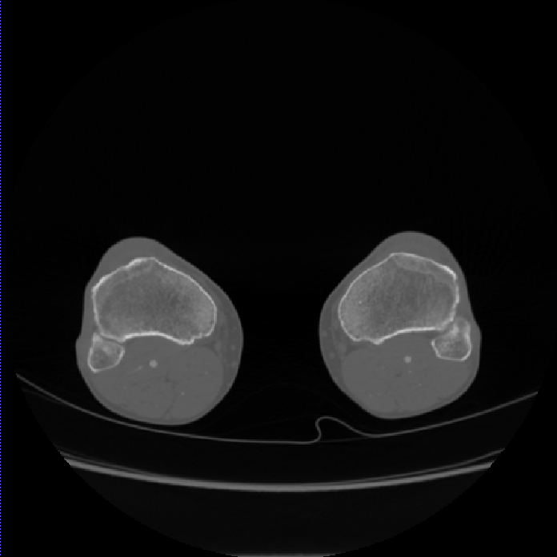
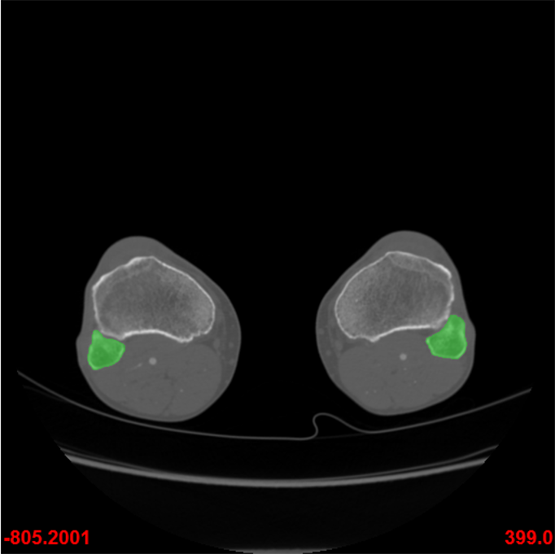
Dataset
Serial number | Number of CT slices in one scan | Distance between each slice (mm)
1 | 734 | 0.6
2 | 670 | 0.6
3 | 790 | 0.6
4 | 786 | 0.6
5 | 794 | 0.6
6 | 799 | 0.6
7 | 810 | 0.6
8 | 951 | 0.6
9 | 803 | 0.7
10 | 767 | 0.8
11 | 761 | 0.8
12 | 999 | 0.625
13 | 1543 | 0.4
14 | 901 | 0.7
15 | 759 | 0.7
16 | 797 | 0.7
17 | 774 | 0.8
18 | 409 | 1.5
19 | 983 | 0.6
Original CT slice
Experts' manual annotations
Examples in the data set
Notes:
There are two examples in the data set, the left figure is the original CT slice.
On the right figure, the corresponding fibula is already marked by experts.
In the table, we can notice that there are different numbers of CT slices in each CT scan
and the distance between each slice are also different.

Slide 12
Outline
Motivation
Dataset & Data preprocessing
Data Preparation
Data Preprocessing
Methodology & Experiments
Conclusion
Notes:
王 Then we introduce data preprocessing.

Slide 13
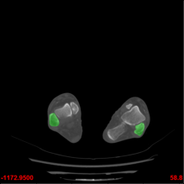
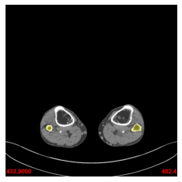
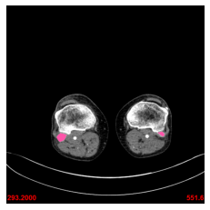
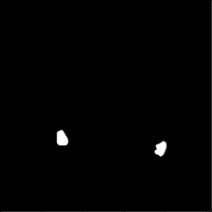

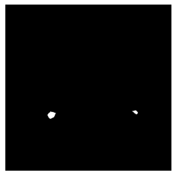
Data preprocessing
The original data of the manual annotations
the ground truth after HSV processing
Notes:
For manual annotations, different colors used for markers. (动画1）
So, HSV (hue, saturation, value) color space extraction is used to select the colored part.
In this way, manual annotations were transferred to 19 3D matrices which can be used for ground truth.
(First read the number of all bmp files in a single patient folder, and then extract all bmp file information to construct a 3D matrix.)

Slide 14
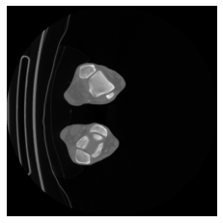
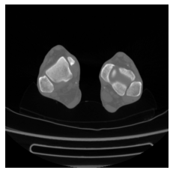
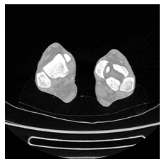

Data preprocessing
Convolution kernel
$$\left[\begin{matrix}−1 & −1 & −1 \\ −1 & 10 & −1 \\ −1 & −1 & −1\end{matrix}\right]$$
Convolution enhancement
Crop
384 x 384
384 x 384
512 x 512
For boundary enhancement
Notes:
To reduce the size of images in dataset, the 512 by 512 size is cropped to 384 by 384 size. (动画1)
After processing the original image into 3D matrix and cropping, the sequence of images that can be used as input is obtained.
In order to better identify the edge part of the fibula region, we choose convolution enhancement method for image boundary enhancement.
The convolution kernel we used is shown in the figure.

Slide 15
Outline
Motivation
Dataset & Data preprocessing
Methodology & Experiments
Evaluation criterion
Single-planar segmentation model
Multi-planar segmentation model
Multi-planar segmentation model with data augmentation
Conclusion
Notes:
李 Then, in the methodology and experiment's part. First, we introduce the evaluation criterion.

Slide 16
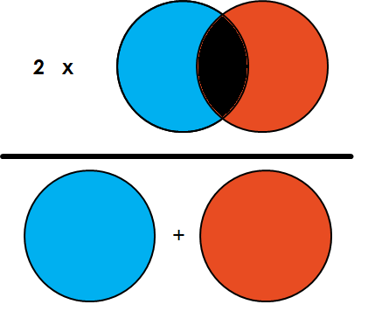
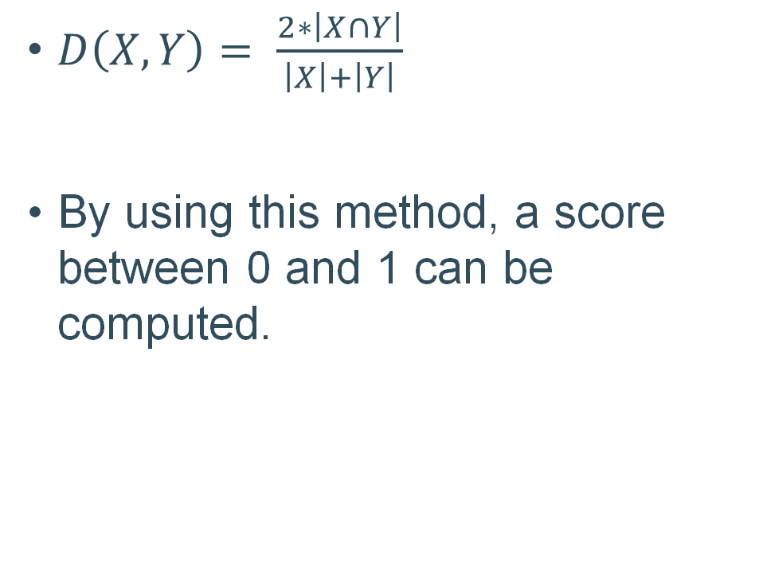
Dice Score
$D\left(X,Y\right)= \frac{2∗\left|X∩Y\right|}{\left|X\right|+\left|Y\right|}$
By using this method, a score between 0 and 1 can be computed.
Notes:
To evaluate the accuracy of fibula segmentation, we use the Dice score.
Formula is shown there.
It is Two times Area of Overlap divided by the total number of pixels in both images,
where X is the ground truth area and Y is the prediction area from the network.
Using this method, we can get a score between 0 and 1.
0 means completely inconsistent and 1 means totally consistent.

Slide 17
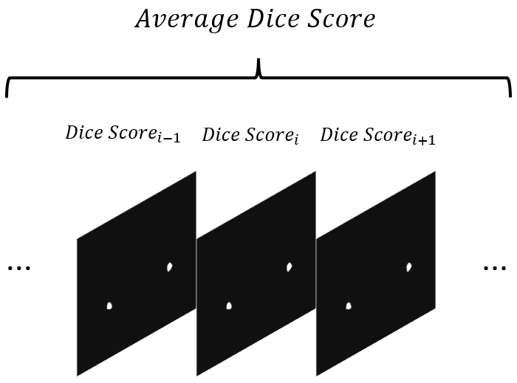
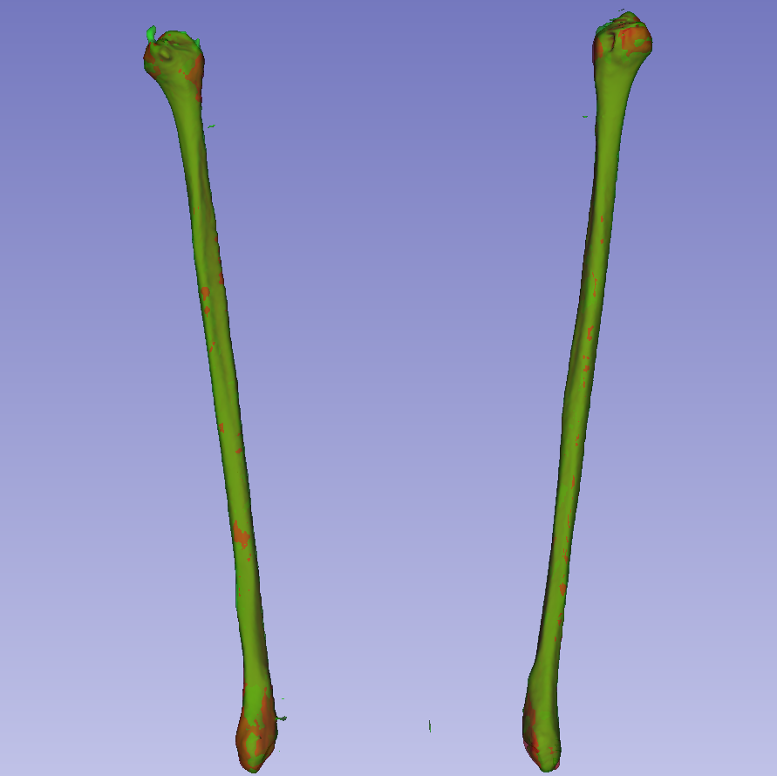
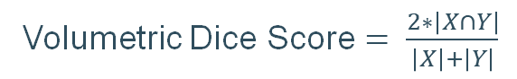
Two method of Dice Score
Average Dice score
Average of each dice score in one CT scan.
Focus more on evaluating the whole output
Volumetric Dice score
Overlap voxel area
Pay more attention to the evaluation of fibula.
Volumetric Dice Score $= \frac{2∗\left|X∩Y\right|}{\left|X\right|+\left|Y\right|}$
Notes:
In this research, data is converted between 2D and 3D formats, so we use two Dice score method to evaluate prediction comprehensively.
In the first method, the average Dice score means the average of each DICE SCORE from one CT scan.
In the second method, volumetric Dice score use the overlap voxel area instead of the pixel.
The averaging algorithm focuses more on evaluating the whole output which means the entire leg.
The volume algorithm pays more attention to the evaluation of fibula.

Slide 18
Outline
Motivation
Dataset & Data preprocessing
Methodology & Experiments
Evaluation criterion
Single-planar segmentation model
Multi-planar segmentation model
Multi-planar segmentation model with data augmentation
Conclusion
Notes:
王 Next, we introduce the single-planar segmentation model.

Slide 19
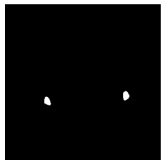
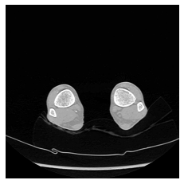
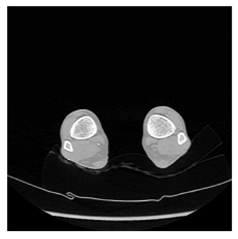
Single-planar segmentation model
16 channels
1 channel
Axial
1 channel
384x384
Conv
384x384
384x384
Skip Connection
192x192
64 channels
192x192
32 channels
96x96
64 channels
256 channels
96x96
64 channels
96x96
Conv 7x7
48x48
512 channels
MaxPool
48x48
128 channels
Resnet Block
24x24
1024 channels
24x24
256 channels
Upsampling
Encoder
Decoder
2048 channels
12x12
Skip Connection
Notes:
This model is based on the traditional U-Net and combined with Res-Net.
The input of this model is a 2-dimension slice, and the output is a 2-dimension matrix with predicted possibility of each pixel.
(动画1) In the encoder part, the input through a 7 by 7 convolution and a maxpooling layer, then stacking the res-net blocks to reach a deep layers.
In this process, the features were extracted, the resolution was reduced, and channels were increased.
(动画2）In the decoder part, the features of smaller size were gradually up-sampled to the original image size.
(动画3）For the skip connection, In the U-Net structure, deep and shallow information were fused through a skip connection. Skip connections enable the network to propagate the spatial information from the encoder to the decoder.
（A channel can be regarded as a basic unit that carried high-level semantic information. With the increase of network layer depth, the extracted semantic information increases, and more units are needed to express semantic information. Therefore, a large number of channels are needed in the deep network. As the network deepens, the resolution decreases, while the number of channels increases.）
加上axial

Slide 20
Single-planar segmentation model: Res-Net block
16 channels
1 channel
1 channel
384x384
Conv
384x384
384x384
192x192
64 channels
192x192
32 channels
96x96
64 channels
256 channels
96x96
64 channels
96x96
Conv 7x7
48x48
512 channels
MaxPool
48x48
128 channels
Resnet Block
24x24
1024 channels
24x24
256 channels
Upsampling
2048 channels
12x12
Skip Connection
Notes:
To better understand this model, next we will introduce the details of res-block, up-sampling and skip connection.
(动画1）First is the Res-net block, it is in the encoder part and play a role of down-sampling .
Res-Net is formed by stacking this block, and we use the similar architecture in our model’s encoder part.

Slide 21
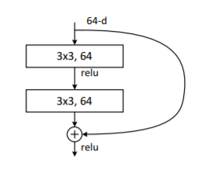
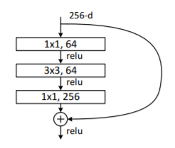
Res-Net block
Traditional Res-Net consists of building blocks or bottlenecks
The structure of the building block for ResNet-18 and ResNet-34
The structure of the bottleneck block for ResNet-50 and higher Res-Net
Notes:
Traditional Res-Net consists of two kinds of Res-block: building blocks or bottlenecks. These Res-Nets were formed by stacking one of the res-net block.
(动画1）
The figure on the left shown the building block for low layer Res-Net. This type of building block consisted of two 3 by 3 convolutions and were stacked to the deeper layers.
(动画2）
The figure on the right shown the bottleneck block for higher layer Res-Net, the bottleneck block is similar to the building block, but consists of two 1 by 1 convolutions and one 3 by 3 convolution.
By using res-net block, we can solve the problem of vanishing and exploding gradients.
(the three layers was initially able to reduce the number of channels to a quarter through a 1x1 convolution, which was then followed by a 3x3 convolution. In the middle convolution layer, the channels of input and output were equal. The third convolution was 1x1, which was used to increase the number of channels in order to keep the same number of output channels and input channels of a bottleneck. These two 1x1 convolutions can effectively reduce the number of parameters as well as the computation of the convolution.)

Slide 22
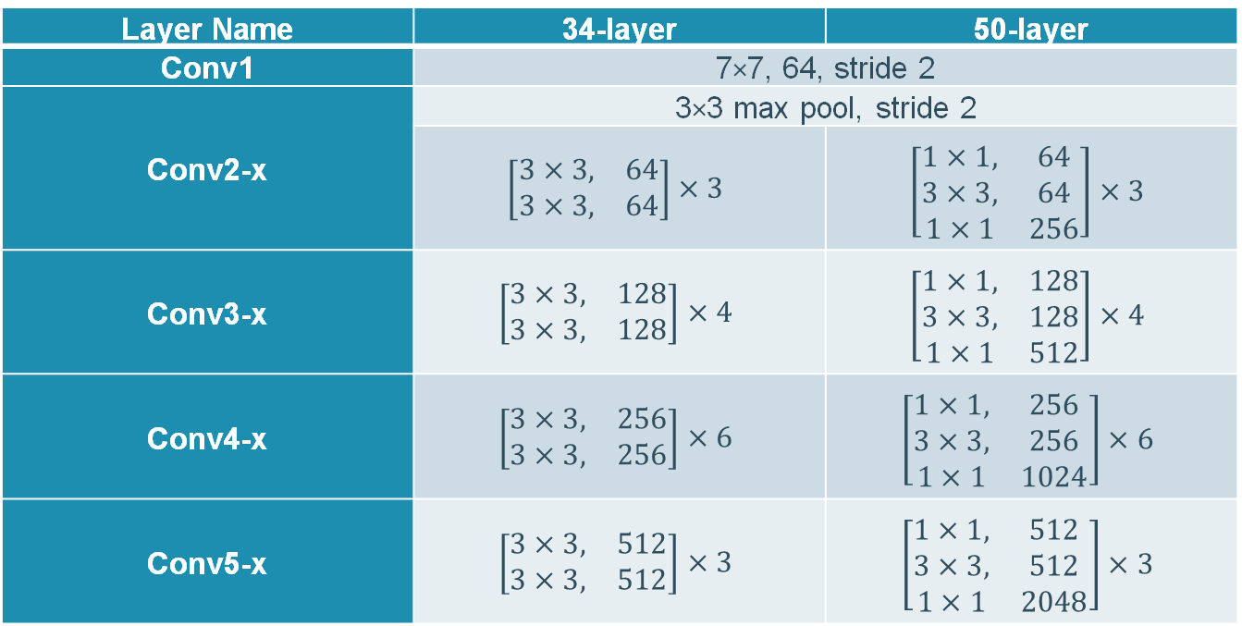
Res-Net architecuture
The Architectures for 34 layers and 50 layers Res-Net
Layer Name | 34-layer | 50-layer
Conv1 | 7×7, 64, stride 2
Conv2-x | 3×3 max pool, stride 2
 | $$\left[\begin{matrix}3×3, & 64 \\ 3×3, & 64\end{matrix}\right]×3$$ | $$\left[\begin{matrix}1×1, & 64 \\ 3×3, & 64 \\ 1×1 & 256\end{matrix}\right]×3$$
Conv3-x | $$\left[\begin{matrix}3×3, & 128 \\ 3×3, & 128\end{matrix}\right]×4$$ | $$\left[\begin{matrix}1×1, & 128 \\ 3×3, & 128 \\ 1×1 & 512\end{matrix}\right]×4$$
Conv4-x | $$\left[\begin{matrix}3×3, & 256 \\ 3×3, & 256\end{matrix}\right]×6$$ | $$\left[\begin{matrix}1×1, & 256 \\ 3×3, & 256 \\ 1×1 & 1024\end{matrix}\right]×6$$
Conv5-x | $$\left[\begin{matrix}3×3, & 512 \\ 3×3, & 512\end{matrix}\right]×3$$ | $$\left[\begin{matrix}1×1, & 512 \\ 3×3, & 512 \\ 1×1 & 2048\end{matrix}\right]×3$$
Notes:
The Architectures of 34 layers and 50 layers Res-Net were shown in figure.
These network structures are all started with a convolution，followed by a max-pooling layer, then stacking single basic module to reach the deeper layers.
Multiple n means this block repeat and stacking n times.
(动画1)Take the convolution layer two as an example, these 2 convolutions block multiple 3 means repeat 3 times in the network.
In experiments part, we will test the performance of these two kind of Res-Nets.

Slide 23
Upsampling
10 |  | 4 |  | 22
2 |  | 18 |  | 7
9 |  | 14 |  | 25
10 | 10 | 4 | 4 | 22 | 22
10 | 10 | 4 | 4 | 22 | 22
2 | 2 | 18 | 18 | 7 | 7
2 | 2 | 18 | 18 | 7 | 7
9 | 9 | 14 | 14 | 25 | 25
9 | 9 | 14 | 14 | 25 | 25
10 | 4 | 22
2 | 18 | 7
9 | 14 | 25
3 x 3
6 x 6
6 x 6
Nearest Neighbor Interpolation
Notes:
李 Another point is how to upsampling. We use the nearest Neighbor Interpolation method.
It is the most basic method which requires the least processing time.
It only considers one pixel which is the closest one to the interpolated point as shown in the figure.
(torch.nn.functional.interpolate)

Slide 24
Skip connection
16 channels
1 channel
1 channel
384x384
Conv
384x384
384x384
192x192
64 channels
192x192
32 channels
96x96
64 channels
256 channels
96x96
64 channels
96x96
Conv 7x7
48x48
512 channels
MaxPool
48x48
128 channels
Resnet Block
24x24
1024 channels
24x24
256 channels
Upsampling
2048 channels
12x12
Skip Connection
Notes:
The last point is the skip connection.
(动画1）We introduce this point by using the circled part as an example.

Slide 25
Skip connection
512 channels
48x48
48x48
128 channels
128 channels
Conv
48x48
24x24
768 channels
256 channels
48x48
Concatenate
512+256=768
256 channels
512 channels
48x48
Skip connection
48x48
256 channels
upsampling
24x24
Notes:
The left part is the circled example. The details are shown on the right part.
In order to show it more clearly, we show these in different color.
(动画1）In the decoder part, the 24 by 24 tensor is up-sampled to double resolution.
(动画2*2）After that, the skip connection concatenate the tensor with same resolution between encoder part and decoder part.
The channel of result is the sum of these two tensors.
After convolution, the number of channels decreased to 128 and this tensor go to the next up-sampling.
(Spatial domain information is very important for the segmentation task. In the encoder part of the network, the feature map resolution is reduced to a very small level through all layers, which is not conducive to the generation of accurate segmentation mask. The features of shallow convolution layer can be introduced through skip-connection, which have high resolution and shallow layer number. It contains rich low-level information, which is more conducive to the generation of segmentation mask.)

Slide 26
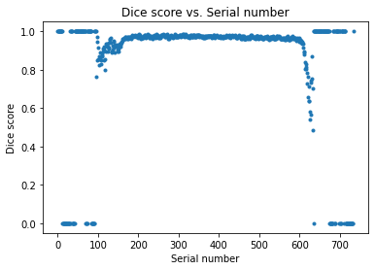
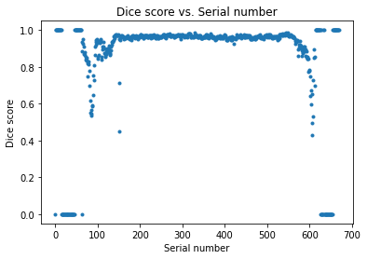
Experiment 1: 34-layer Res-Net in signle-planar model
Test set 1
Test set 2
 | Average Dice Score | Volumetric Dice Score
Test set 1 | 0.863 | 0.920
Test set 2 | 0.859 | 0.917
Notes:
王
Then we start to introduce our experiment results, In the Experiment 1, we use the 34-layer Res-Net in single-planar segmentation model.
The Dice Score result of two methods in two tests shown in the table.
The two figures shows the distribution dice score of all the images with serial number in two tests.
These distribution figures help us to know the prediction accuracy of each image directly.
（动画1）From the distribution figure, we can notice there are lots of 0 dice score, which means the prediction is complete incorrect.

Slide 27
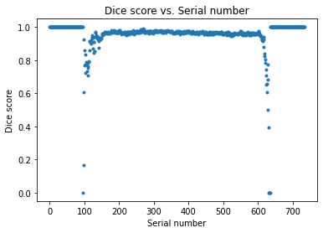
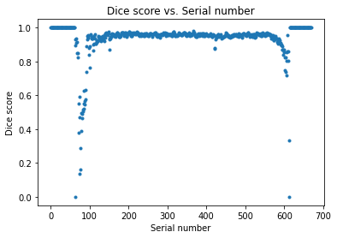
Experiment 2: 50-layer Res-Net in single-planar model
Test set 1
Test set 2
 | Average Dice Score | Volumetric Dice Score
Test set 1 | 0.952 | 0.946
Test set 2 | 0.884 | 0.906
Notes:
Then, in the Experiment 2, we change to use the 50-layer Res-Net in single-planar segmentation model.
The Dice Score result of two methods in two tests shown in the table.
(动画1）From the distribution figures, we can notice that the number of zero dice score decreased.

Slide 28
Experiment 2: 50-layer Res-Net in single-planar model
Epiphysis part
Test set 1
Test set 2
Epiphysis part
 | Average Dice Score | Volumetric Dice Score
Test set 1 | 0.952 | 0.946
Test set 2 | 0.884 | 0.906
Notes:
Further analyze the distribution figure, the prediction of images around serial number 100 and 600 are poor.
These parts are the two ends of a bone, （动画1）which called epiphysis part in medicine.
(动画2) This is the epiphysis, in the two ends of bone, which is the joint part.

Slide 29
Experiment 2: 50-layer Res-Net in single-planar model
Diaphysis part
Test set 1
Test set 2
Diaphysis part
 | Average Dice Score | Volumetric Dice Score
Test set 1 | 0.952 | 0.946
Test set 2 | 0.884 | 0.906
Notes:
And, the middle part of a bone is called diaphysis part in medicine. (动画1）
The dice scores of this part are close to 1, which means the prediction is perfect.
（动画2） This is the diaphysis part, in the middle of a bone.

Slide 30
Comparison of Experiment 1 and 2
 | Test set 1 average Dice score | Test set 2 average Dice score | Test set 1 volume Dice Score | Test set 2 volume Dice Score
34-layer Res-Net | 0.863 | 0.859 | 0.920 | 0.917
50-layer Res-Net | 0.952 | 0.884 | 0.946 | 0.906
→ Adopt 50-layer Res-Net structure for single –planar segmentation model
Notes:
李 After analyzing the distribution figure and dice score of two tests,
we concluded that the 50-layer Res-Net is more suitable for the single-planar segmentation model in this research.
In subsequent experiments, we will adopt 50-layer Res-Net structure!!

Slide 31
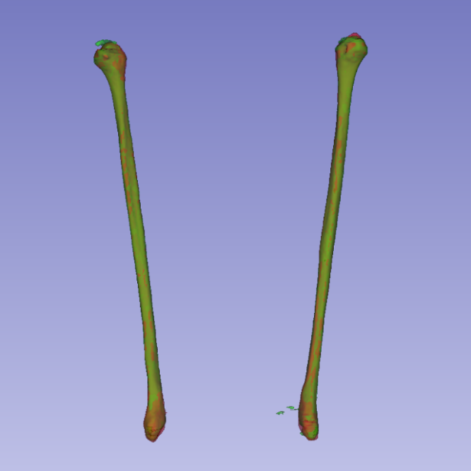
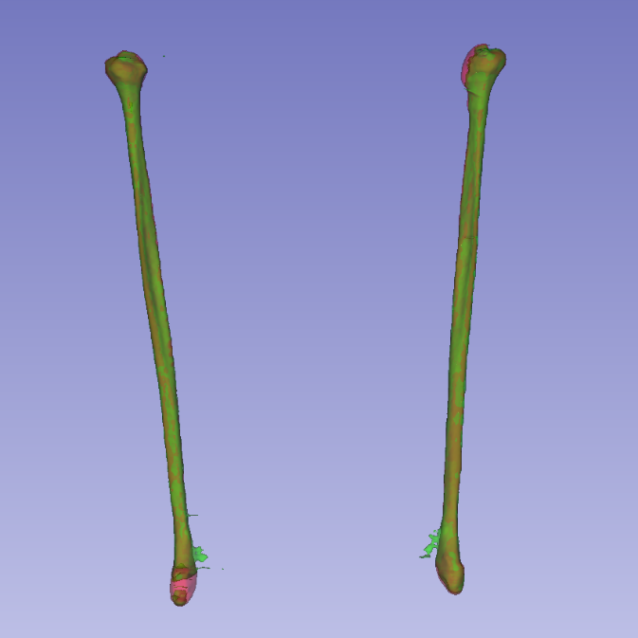
Discussion for Experiment 2: 50-layer Res-Net in single-planar model
2.00
2.00
1.50
1.50
1.00
1.00
0.50
0.50
0.00
0.00
Test set 1
Test set 2
Notes:
The prediction were stacking into 3D and represented in green, while the ground truth was represented in red.
From the Figure, we can see the overlap between the predicted segmentation and manual segmentation directly.
(动画1）In the three circled parts, the overlap region between prediction and manually annotations are not too much, which means prediction perform poor in these regions.
This confirms previous analyses: the prediction of epiphysis part is worse than the diaphysis part.

Slide 32
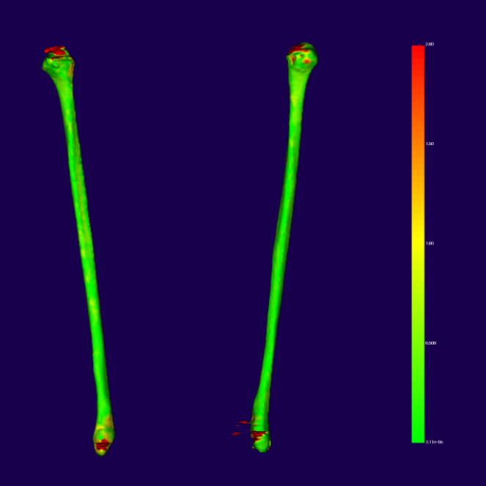
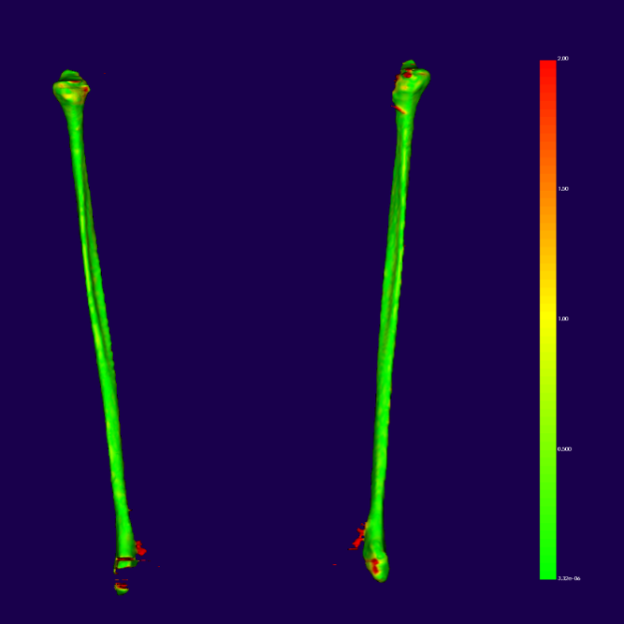
Discussion for Experiment 2
2.00
2.00
2.00
2.00
1.50
1.50
1.50
1.50
1.00
1.00
1.00
1.00
0.50
0.50
0.50
0.50
0.00
0.00
0.00
0.00
Test set 1
Test set 2
Notes:
Surface distance map shows the absolute distance from each point to the closest ground truth.
This map visualized the deviation degree of each part of the segmentation result.
This unit in picture is millimeter.
(Deviations close to 2mm tend to approach red, while 0mm means prediction perfect match the ground truth and approach green.)

Slide 33
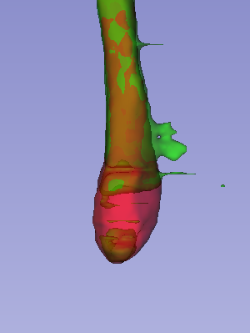
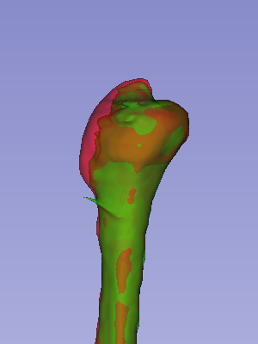
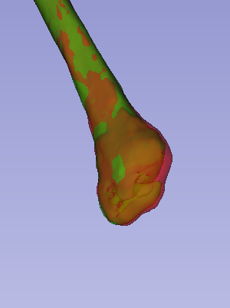
Two method to improve epiphysis segmentation
Information combination
Data augmentation
Notes:
The three figures show the poor performance prediction parts.
To improve these epiphysis prediction, we plan to apply two methods: information combination and data augmentation.

Slide 34
3D Network to 2.5D Network
3D network (3D Unet)
(Regardless of computing and VRAM)
Combine the information between image slices
Ensure the continuity
Better than 2D network
Drawbacks for fibula segmentation
limitation of the VRAM (800x384x384)
Cannot take the entire 3D metric as input
Crop to a series of 3D patches
Network is difficult to learning the overall structure
Multi-planar combination (2.5D Network)
Notes:
Regardless of computing and VRAM performance, Because the 3D network can combine the information between image layers, it can ensure the continuity between image masks of different layers, and the performance will be better compared with 2D
But 3D networks have obvious drawbacks for fibula segmentation
As you can see that the size of leg CT scan is so large.
Because of the limitation of the VRAM, it is impossible to take the entire 3D metric as input. So the Cropping is needed. Then the input is a series of 3D patches. By this way, it will drop some information of overall structure.
(动画1) So a suitable method for this task is Multi-planar combination, which is a 2.5D network.

Slide 35
Outline
Motivation
Dataset & Data preprocessing
Methodology & Experiments
Evaluation criterion
Single-planar segmentation model
Multi-planar segmentation model
Multi-planar segmentation model with data augmentation
Conclusion
Notes:
Now, we introduce the multi-planar segmentation model

Slide 36
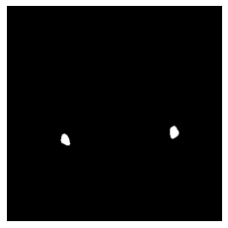

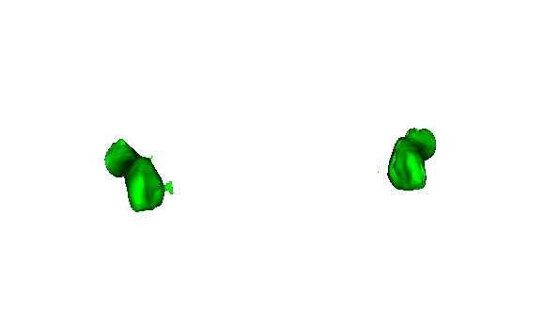
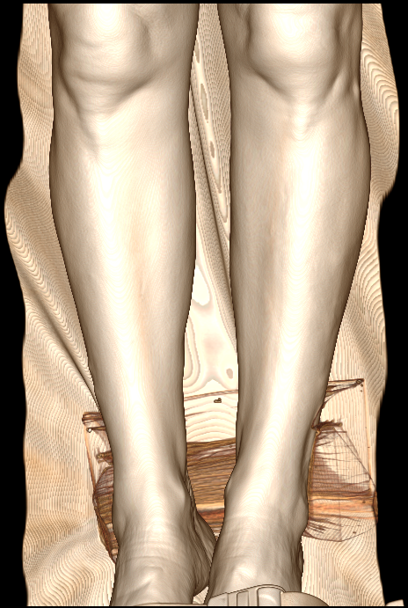



















Multi-planar segmentation model
Axial
Input CT Scan
Axial plane
Single-planar CNN
Stacking
···
···
···
···
Combination
Sagittal
Sagittal plane
Stacking
···
···
···
···
Coronal plane
Stacking
Coronal
···
···
···
···
Notes:
. (动画1）
Multi-planar network considered the structural information from different planes, including the axial, sagittal and coronal planes.（动画2）
As you can see
First, The volume data was converted from each plane.（动画3）
Then, the three planes input through the corresponding single-planar sub-network.（动画4）
After that, we obtain the automatic segmentation result of each planar. （动画5）
Finally, the maximum probability from different planes combined as the final prediction.（动画6）
So by this way, the information of different planes can be combined.

Slide 37
Maximum Probability Combination
0.1 | 0.4 | 0.1
1 | 0.9 | 0.4
0.2 | 0.9 | 0.3
$$Y=\max\left\{Y_{a},Y_{s},Y_{c}\right\}$$
0.2 | 0.4 | 0.2
1 | 0.8 | 0.5
0.3 | 0.9 | 0.1
0.2 | 0.5 | 0.2
1 | 0.9 | 0.5
0.3 | 1 | 0.3
Maximum Probability Combination
0.1 | 0.5 | 0.1
1 | 0.8 | 0.4
0.2 | 1 | 0.1
Notes:
Maximum probability combination is the main approach to achieved multi-planar combination.
We select the maximum probability of each voxel from the three networks.
It can effectively combine the predicted information, improve the accuracy of final result.

Slide 38
Cropping the region of interest (CROI) method
The input image for single-planar segmentation model is 384x384
Different resolution (384x734,384x670…)
Predicted performance of epiphysis part is worse than the diaphysis part
Focus on data at epiphysis part
Cropping the region of interest (CROI)
Notes:
王
In this research, the scale of input image for single-planar segmentation model is 384 by 384.
However, if we obtain the segmentation from sagittal plane and coronal plane, the obtained images have different resolutions from different CT scan.
In the previous experiments, we notice that the predicted performance of epiphysis part is worse than the diaphysis part.
So, we use a Cropping the region of interest method to process the images from sagittal plane and coronal plane.
This method focus on preserving data at both ends.(动画1）
This method is shorten to CROI.

Slide 39






Cropping the region of interest (CROI) method (For sagittal and coronal)
Single-plane CNN
Maximum probability
734
734
384
2×384×384
2×384×384
384
Notes:
In the figure, we take an image from sagittal plane as example, the original size is 734 by 384, after divided into two fixed squares from both ends to the middle (384x384 pixels), these two images are through the single-planar separately and combined according to the maximum probability.

Slide 40






Cropping the region of interest (CROI) method (For sagittal and coronal)
Single-plane CNN
Maximum probability
951
951
2×384×384
2×384×384
384
384
Notes:
In this figure is another example, we can notice in this situation, the CROI method will abandon the middle part of original image.
This will not influence the prediction, because multi-planar model use maximum probability to combine, so the final result will still be complete.

Slide 41


Experiment 3：Multi-planar segmentation model Combination result
 | Test set 1 average Dice score | Test set 2 average Dice score | Test set 1 volume Dice Score | Test set 2 volume Dice Score
Axial plane | 0.956 | 0.938 | 0.947 | 0.923
Sagittal plane | 0.942 | 0.938 | 0.908 | 0.909
Coronal plane | 0.946 | 0.945 | 0.918 | 0.896
Combination result | 0.945 | 0.856 | 0.932 | 0.883
Notes:
The two method of DICE score for two tests shown in the figure. We can notice that the Dice score of two tests are lower than the result of axial plane.
In order to analyze the prediction of combination in details, we obtain the axial distribution figures.

Slide 42
Experiment 3：Multi-planar segmentation model Combination result
 | Test set 1 average Dice score | Test set 2 average Dice score | Test set 1 volume Dice Score | Test set 2 volume Dice Score
Axial plane | 0.956 | 0.938 | 0.947 | 0.923
Sagittal plane | 0.942 | 0.938 | 0.908 | 0.909
Coronal plane | 0.946 | 0.945 | 0.918 | 0.896
Combination result | 0.945 | 0.856 | 0.932 | 0.883
Notes:
From the distribution figure, we can notice that the prediction of the epiphysis is improved, the prediction of the diaphysis is worse than before.
This can prove that multi-planar segmentation model is helpful to improve the prediction of the epiphysis part.
Although the dice scores are decreased from table, this method is still valuable.

Slide 43




Experiment 3：Multi-planar segmentation model Coronal plane subnetwork
Test set 1
Too few useful parts
Result is poor
Test set 2
Notes:
After analyzing the three planar results, we find the coronal plane has only few useful parts.
These four figures are the distribution dice score of two tests with two parts after using CROI method.
We can notice that the slices with fibula parts only have a small proportion.
(动画1）From the figures, the coronal prediction of fibula performs poor.
(The distribution dice score of all the images with odd and even serial number in Test set 1 and Test set 2 .
The dice score of images with odd serial number on the left, the dice score of images with odd serial number on the right. )

Slide 44


Discussion for Experiment 3: Multi-planar segmentation model
Test set 1
Test set 2
Notes:
The combined prediction in 3D shown in figures.
We can see that the predicted part of the fibula coincides with the manual annotations,
(上动画）but there still exist a lot of impurities that were incorrect prediction, which lead to lower dice score.
These impurities are thin and mostly exist in coronal plane.

Slide 45


Discussion for Experiment 3
1.00
1.00
0.75
0.75
0.50
0.50
0.25
0.25
0.00
0.00
Test set 1
Test set 2
Notes:
We also generate the surface distance map. The unit is millimeter.
To improve the model and reduce the incorrectly predicted part, data augmentation is necessary.
In the next experiment, the method of data augmentation will be tried, we will still use multi-planar combination but consider only use axial plane and sagittal plane.
(the red area in the fibula part is reduced, which means that the prediction is better in main fibula bone. )

Slide 46
Outline
Motivation
Dataset & Data preprocessing
Methodology & Experiments
Evaluation criterion
Single-planar segmentation model
Multi-planar segmentation model
Multi-planar segmentation model with data augmentation
Conclusion
Notes:
李 In the next part, we will introduce data augmentation.

Slide 47


Data Augmentation
Images
Ground Truth
Original
b
c
Original
Translation: b. 50 to the right and 30 downwards c. 50 to the left and 30 upwards
Scale: 1.3 times.
Notes:
In this experiment, data augmentation including translation, scale, rotation, and Gaussian noise.
In the translation part, the distance moved in the horizontal direction is 50 and in the vertical direction is 30.
For the scale part, the image is enlarged by 1.3 times from the center, as shown on the right side of Figure.

Slide 48


Data Augmentation
Images
Ground Truth
Original
Counter
clockwise
Clockwise
Original
Rotate: 15 degrees rotate, and 1.3 times enlarged
Gaussian noise: an average of zero and a standard deviation of 1
Notes:
For the rotation part, we rotated the image by 15 degrees and enlarged the image by 1.3 times.
Gaussian noise is a moderate noise which can extract new samples and smoothing the structure of the input.
In this research, Gaussian noise with mean value of 0 and a standard deviation of 1 was added.

Slide 49
Data Augmentation
Axial:
Select epiphysis part manually from train set
2160 to 10,800
Sagittal:
Select slices included the fibula bone
2830 to 14,150
Add to original train set
Notes:
Because of the poor performance of coronal plane, we only use the axial plane and sagittal plane for combination.
And as we said before, we focus on improving the prediction of epiphysis part.
For Axial plane data, we selected epiphysis part manually from train set, each image becomes five images after data augmentation.
For sagittal plane data, we selected the CROI images which included the fibula bone for data augmentation.
All the new samples were added to original train set as a new train set.

Slide 50
Final segmentation model
Input CT Scan
Axial
Axial plane
Single-planar CNN
DA
Stacking
Combination
···
···
···
···
Sagittal
Sagittal plane
DA
Stacking
···
···
···
···
Data augmentation
Multi-planar segmentation only with axial plane and sagittal plane.
Notes:
After these experiments, we choose data augmentation combined with multi-planar segmentation model.
First, The volume data was converted from axial and sagittal direction.(动画1）
Then, the two planes input through the data augmentation to increase the samples. （动画2）
Next, the data after augmentation through the corresponding single-planar sub-network.（动画3）
After that, we obtain the automatic segmentation result of axial plane and sagittal plane. （动画4）
Finally, the maximum probability method is used to get the final prediction.（动画5）

Slide 51


Experiment 4 Axial segmentation result on axial slices after data augmentation
 | Test set 1 average Dice score | Test set 2 average Dice score | Test set 1 volume Dice Score | Test set 2 volume Dice Score
Axial plane | 0.956 | 0.938 | 0.947 | 0.923
Axial plane After Data Augmentation | 0.967 | 0.943 | 0.957 | 0.944
Sagittal plane | 0.942 | 0.938 | 0.908 | 0.909
Sagittal plane After Data Augmentation | 0.961 | 0.972 | 0.955 | 0.964
Data Augmentation Combination | 0.967 | 0.944 | 0.957 | 0.946
Test set 1
Test set 2
Notes:
王 From the table, we can notice that, for axial plane, the data augmentation increase the dice score of two tests.
And from the distribution figure, the dice scores of diaphysis part are close to 1 (动画1) and most epiphysis parts’ dice scores are higher than 0.8 (动画2) .

Slide 52


Experiment 4 Sagittal segmentation result on axial slices after data augmentation
 | Test set 1 average Dice score | Test set 2 average Dice score | Test set 1 volume Dice Score | Test set 2 volume Dice Score
Axial plane | 0.956 | 0.938 | 0.947 | 0.923
Axial plane After Data Augmentation | 0.967 | 0.943 | 0.957 | 0.944
Sagittal plane | 0.942 | 0.938 | 0.908 | 0.909
Sagittal plane After Data Augmentation | 0.961 | 0.972 | 0.955 | 0.964
Data Augmentation Combination | 0.967 | 0.944 | 0.957 | 0.946
Test set 1
Test set 2
Notes:
From the table, we can notice that, for sagittal plane, the data augmentation also increase the dice score of two tests.
And from the distribution figure, the dice scores of diaphysis part are close to 1(动画1） and most epiphysis parts’ dice scores are higher than 0.8（动画2).
In the Test set 2, the lowest dice score is 0.7. (动画3) Most dice score is higher than 0.85.

Slide 53


Experiment 4 Combination segmentation result on axial slices after data augmentation
 | Test set 1 average Dice score | Test set 2 average Dice score | Test set 1 volume Dice Score | Test set 2 volume Dice Score
Axial plane | 0.956 | 0.938 | 0.947 | 0.923
Axial plane After Data Augmentation | 0.967 | 0.943 | 0.957 | 0.944
Sagittal plane | 0.942 | 0.938 | 0.908 | 0.909
Sagittal plane After Data Augmentation | 0.961 | 0.972 | 0.955 | 0.964
Data Augmentation Combination | 0.967 | 0.944 | 0.957 | 0.946
Test set 1
Test set 2
Notes:
The combination results is shown.
In general, the dice score for two tests are improved. (动画1）The predicted results for both epiphysis and diaphysis parts are higher than 0.9, which means close to the manual annotations.

Slide 54


Discussion for Experiment 4: Multi-planar segmentation model with data augmentation
Test set 1
Test set 2
Notes:
Figures shown the comparison of manual annotation and prediction in 3D of two tests.
Compared with the prediction in experiment 2 and 3, the red area and green area almost overlap.
The results are more consistent and slightly improved overall.

Slide 55


Discussion for Experiment 4: Multi-planar segmentation model with data augmentation
1.00
1.00
0.75
0.75
0.50
0.50
0.25
0.25
0.00
0.00
Test set 1
Test set 2
Notes:
Figures shown the surface distance map (mm) of two tests.
Compared with experiment 2 and 3, the red areas of surface distance map are decreased, which means that the predicted results are closer to the manual segmentation results.
The impurities are reduced, the results are more consistent and smoother.

Slide 56
Outline
Motivation
Dataset & Data preprocessing
Methodology & Experiments
Conclusion

Slide 57
Conclusion
An automatic fibula segmentation neural network
→ proven to be accurate and efficient
The multi-planar segmentation model
→ increased the segmentation accuracy of epiphysis
→ decreased the segmentation accuracy of diaphysis
The data augmentation
→ increased segmentation accuracy for single-planar segmentation and multi-planar segmentation
Applicable for clinical medical fibula segmentation
→ Dice score higher than 0.95
Notes:
First, In this research, we developed an automatic fibula segmentation neural network, which is proven to be accurate and efficient.
The experiment 3 prove that the multi-planar segmentation model increased the accuracy of epiphysis part but decreased the accuracy of diaphysis part.
The experiment 4 prove that the data augmentation performs well and increased accuracy for single-planar segmentation and multi-planar segmentation.
Finally, after the evaluation by dr. Yi Sun, it can be used for clinical application.

Slide 58
Thank You
For Your Attention
Notes:
That is our Master thesis presentation. Thank you for your attention.

Slide 60
x
Conv1x1(stride = 1, in = 64, out = 256)
bn
relu
Conv1x1(stride=1,
in=64,out =256)
Raise dimension
conv
Conv3x3(stride = 1, in = 64, out = 64)
Norm_layer
bn
Maxpool
Conv1x1(stride = 1, in = 64, out = 256)
Layer 1
Bottleneck
bn
Bottleneck
+
Bottleneck
Bottleneck
relu
Layer 2
Bottleneck
x
Resnet50
Bottleneck
Bottleneck
Conv1x1(stride = 1, in = 256, out = 64)
Bottleneck
bn
Layer 3
Bottleneck
Relu
Bottleneck
Bottleneck
Conv3x3(stride = 1, in = 64, out = 64)
Bottleneck
Bottleneck
bn
Conv1x1(stride = 1, in = 64, out = 256)
Layer 4
Bottleneck
bn
Bottleneck
Bottleneck
+
relu
Notes:
accelerate model convergence, shorten training process
batchNormal

Slide 61
x
Conv1x1(stride = 1, in = 256, out = 128)
bn
relu
Conv1x1(stride=2,
in=256,out = 512)
Raise dimension
Downsampling
conv
Conv3x3(stride = 1, in = 128, out = 128)
Norm_layer
bn
Maxpool
Conv1x1(stride = 1, in = 128, out = 512)
Layer 1
Bottleneck
bn
Bottleneck
+
Bottleneck
Bottleneck
relu
Layer 2
Bottleneck
x
Resnet50
Bottleneck
Bottleneck
Conv1x1(stride = 1, in = 512, out = 128)
Bottleneck
bn
Layer 3
Bottleneck
Relu
Bottleneck
Bottleneck
Conv3x3(stride = 1, in = 128, out = 128)
Bottleneck
Bottleneck
bn
Conv1x1(stride = 1, in = 128, out = 512)
Layer 4
Bottleneck
bn
Bottleneck
Bottleneck
+
relu

Slide 62


Results of Experiment 2

Slide 63


Slide 64


Slide 65




Experiment 3 Sagittal plane subnetwork
Notes:
The distribution dice score of all the images with odd and even serial number in Test set 1 is shown in ((a), (b)) and Test set 2 ((c), (d)) from sagittal plane segmentation.
The dice score of images with odd serial number on the left, the dice score of images with odd serial number on the right.

Slide 66
Experiment 3 Coronal plane subnetwork
1. Too few useful parts
2. Result is poor
Notes:
分析C面看出有用信息很少，包含腓骨的部分对于整体的占比低
The distribution dice score of all the images with odd and even serial number in Test set 1 ((a), (b)) and Test set 2 ((c), (d)) from coronal plane segmentation with 50-layer Res-Net architecture.
The dice score of images with odd serial number on the left, the dice score of images with odd serial number on the right.

Slide 67
Discussion for Experiment 3
1.00
2.00
0.75
1.50
0.50
1.00
0.25
0.50
0.00
0.00
Test set 1
Test set 2
Notes:
来个三面和合成结果四个一起的对比表，介绍一下结果在3D图的效果，说明一下可能存在的两个问题：1.最大值合成导致三个面的错误预测叠加，2.C面不行，有用信息太少
The sequence images of the both tests predicted results were synthesized into 3D and shown in figure, we can see that the predicted part of the fibula coincides with the manual segmentation part, but still exist a lot of impurities that were predicted incorrectly, which lead to lower dice score. These impurities are thin and mostly exist in coronal plane, otherwise the predictions for the main part of fibula are improved.
Surface distance map shows the absolute distance from each point to the closest ground truth, the red area in the fibula part is reduced, which means that the prediction is better in main fibula bone. To improve the model and reduce the incorretly predicted part, data augmentation is necessary. In the next step, the method of data augment will be tried. In the next experiment we will still use multi-planar combination, but consider only use axial plane and sagittal plane.

Slide 68
Discussion for Experiment 4
1.00
1.00
0.75
0.75
0.50
0.50
0.25
0.25
0.00
0.00
Test set 1
Test set 2
Notes:
对结果的3D图进行分析，和之前50层的3D图以及三面合成的3D图做对比，得到结果很好
The comparison of manual annotation and prediction in 3D and the surface distance map (mm) from automatic segmentation to manual segmentation in 3D of two tests shown. Compared with the predicted results in experiment 2 and experiment 3, the results are more consistent and slightly improved overall.
Compared with experiment 2, the red areas decreased, which means that the predicted results are in great agreement with the manual segmentation results.
Compared with experiment 3, the areas of incorrectly predicted are reduced and the results are more consistent and smoother.

Slide 69


